Slide 1


Binomial Random Variables
Binomial Probability Distributions

Slide 2
THE BERNOULLI AND BINOMIAL RANDOM VARIABLES
Suppose that a trial, or an experiment, whose outcome can be classified as either a
success or a failure is performed.
If we let X = 1 when the outcome is a success and
X = 0 when it is a failure, then the probability mass function of X is given by

Slide 3
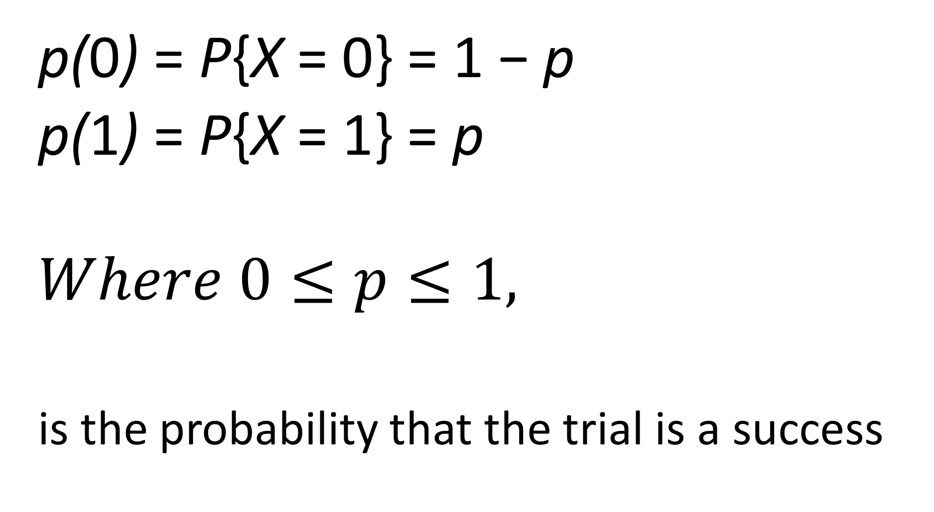
p(0) = P{X = 0} = 1 − p
p(1) = P{X = 1} = p
$$Where 0≤p≤1,$$
is the probability that the trial is a success
(1)

Slide 4
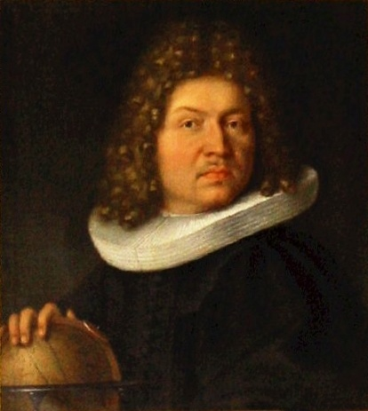
Bernoulli random variable
A random variable X is said to be a Bernoulli random variable
(after the Swiss mathematician James Bernoulli)
if its probability mass function is given
by Equations
(1) for some p ∈ (0, 1).

Slide 5
Binomial Random variable
Suppose now that n independent trials,
each of which results in a success with probability p and in a failure with probability 1 − p, are to be performed.
If X represents the number of successes that occur in the n trials,

Slide 6
then X is said to be a binomial random variable
with parameters (n, p).
Thus, a Bernoulli random variable is just a binomial random variable with parameters (1, p).

Slide 7
The Binomial Distribution
A Binomial Random Variable
n identical trials
Two outcomes: Success or Failure
P(S) = p; P(F) = q = 1 – p
Trials are independent
x is the number of Successes in n trials

Slide 8
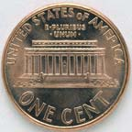
The Binomial Distribution
A Binomial Random Variable
n identical trials
Two outcomes: Success or Failure
P(S) = p; P(F) = q = 1 – p
Trials are independent
x is the number of S’s in n trials
Flip a coin 3 times
Outcomes are Heads or Tails
P(H) = .5; P(F) = 1-.5 = .5
A head on flip i doesn’t change P(H) of flip i + 1

Slide 9
The problem of getting exactly one head in a coin toss 3 times
Suppose a coin is tossed thrice (n), then the sample space consists of ordered pairs or 3- tuples consisting of s –success or f-failure. Let s= getting exactly one head. Then (s,s,s),(s,s,f),(s,f,s),(s,f,f),(f,s,f),(f,f,s),(f,s,s) ,(f,f,f)
The event A of k=1 success consists of all ordered 3-tuples of which 1 Components are s and the other 3-1 =2 (n –k) components are f.

Slide 10
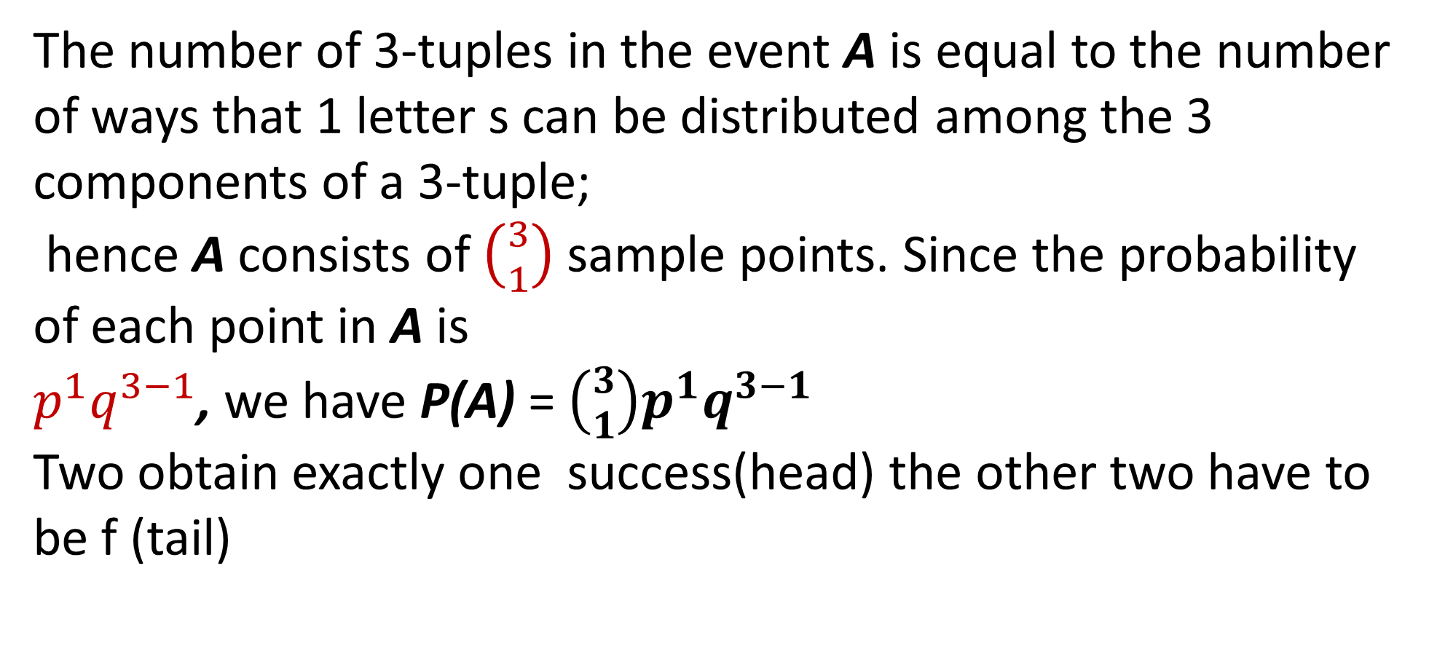
The number of 3-tuples in the event A is equal to the number of ways that 1 letter s can be distributed among the 3 components of a 3-tuple;
hence A consists of $\left({3 \atop 1}\right)$ sample points. Since the probability of each point in A is
$p^{1}q^{3−1}$, we have P(A) = $\left({3 \atop 1}\right)p^{1}q^{3−1}$
Two obtain exactly one success(head) the other two have to be f (tail)

Slide 11
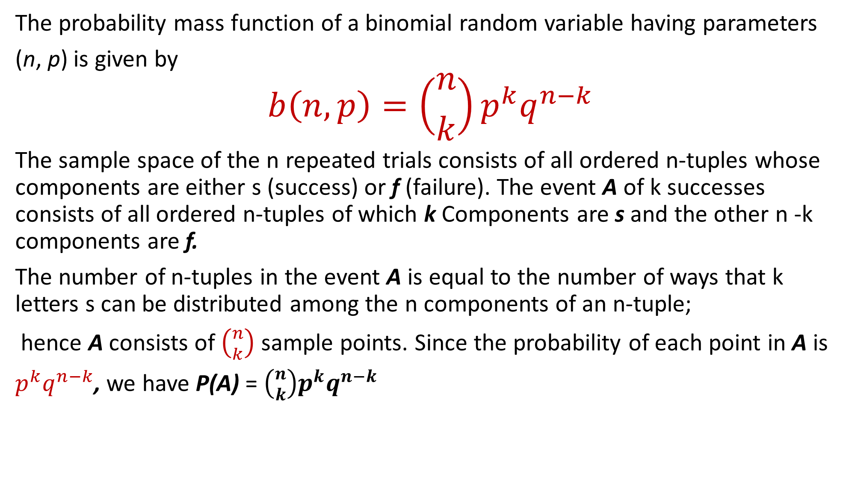
The probability mass function of a binomial random variable having parameters
(n, p) is given by
$$b\left(n,p\right)=\left({n \atop k}\right)p^{k}q^{n−k}$$
The sample space of the n repeated trials consists of all ordered n-tuples whose components are either s (success) or f (failure). The event A of k successes consists of all ordered n-tuples of which k Components are s and the other n -k components are f.
The number of n-tuples in the event A is equal to the number of ways that k letters s can be distributed among the n components of an n-tuple;
hence A consists of $\left({n \atop k}\right)$ sample points. Since the probability of each point in A is
$p^{k}q^{n−k}$, we have P(A) = $\left({n \atop k}\right)p^{k}q^{n−k}$

Slide 12
The Binomial Distribution
The Binomial Probability Distribution
The probability of getting the required number of successes
The probability of getting the required number of failures
The number of ways of getting the desired results

Slide 13
Five fair coins are flipped. If the outcomes are assumed independent, find the probability mass function of the number of heads obtained.

Slide 14




If we let X equal the number of heads (successes) that appear, then X
is a binomial random variable with parameters n = 5, p = 1/2
Hence,

Slide 15
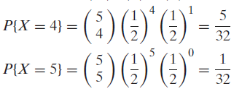

Slide 16
The Binomial Distribution
Say 40% of the class is female.
What is the probability that 6 of the first 10 students walking in will be female?

Slide 17
It is known that bolts produced by a certain company will be defective with probability.01, independently of each other. The company sells the bolts in packages of 10 and offers a money-back guarantee that at most 1 of the 10 bolts is defective.
What proportion of packages sold must the company replace?

Slide 18
If X is the number of defective bolts in a package, then X is a binomial
random variable with parameters (10, .01). Hence, the probability that a package will have to be replaced is

Slide 24
Prove that for a Binomial distribution:

Slide 25
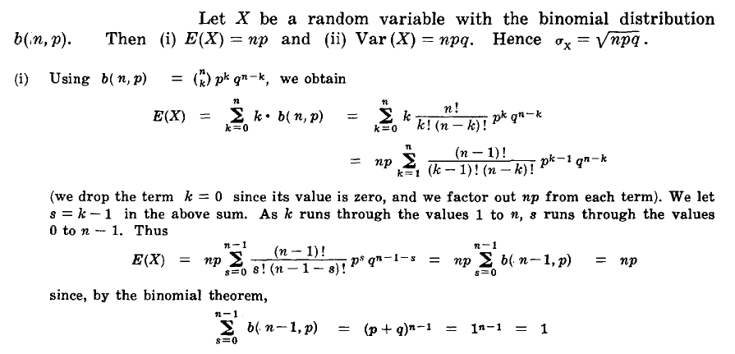

Slide 29
The Binomial Distribution
For 1,000 coin flips,

Slide 30
A marble is drawn from an urn containing 3 white and
3 black marbles. After the marble is drawn, it is replaced
and another marble is drawn. This process goes on
indefinitely. What is the probability that, of the
first 4 marbles drawn, exactly 2 are white?

Slide 31
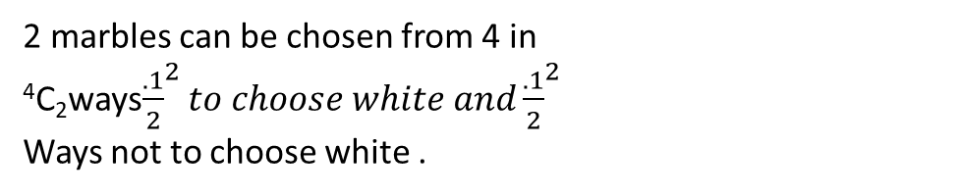
2 marbles can be chosen from 4 in ⁴C₂ways${\frac{.1}{2}}^{2}to choose white and{\frac{.1}{2}}^{2}$
Ways not to choose white .

Slide 32
On a multiple-choice exam with 3 possible answers
for each of the 5 questions, what is the probability
that a student will get 4 or more correct answers
just by guessing?

Slide 33
The probability of answering a question with three possible answers is 1/3.
The number of questions is the number of trials 4
Choosing 4 questions out of 5 is ways.
Atleast 4 questions is the first term with one question wrong and all 5 questions is the second term.

Slide 34
Suppose that, in flight, airplane engines will fail
with probability 1 − p, independently from engine
to engine. If an airplane needs a majority of its
engines operative to complete a successful flight,
for what values of p is a 5-engine plane preferable
to a 3-engine plane?

Slide 36
When coin 1 is flipped, it lands on heads with probability .4; when coin 2 is flipped, it lands on headswith probability .7.
One of these coins is randomly chosen and flipped 10 times.
(a) What is the probability that the coin lands on
heads on exactly 7 of the 10 flips?

Slide 40
Suppose that a particular trait (such as eye color or left-handedness) of a person is classified on the basis of one pair of genes, and suppose that d represents a dominant gene and r a recessive gene. Thus, a person with dd genes is pure dominance, one with rr is pure recessive, and one with rd is hybrid. The pure dominance and the hybrid are alike in appearance. Children receive 1 gene from each parent. If, with respect to a particular trait, 2 hybrid parents have a total
of 4 children, what is the probability that 3 of the 4 children have the outward appearance of the dominant gene?

Slide 41
There ARE 4 pairs of genes a child can receive: dd,rd,dr,rr.
The probability of a dominant gene is ¾ as there are 3 out of 4 cases with a dominant gene.

